Slide 1

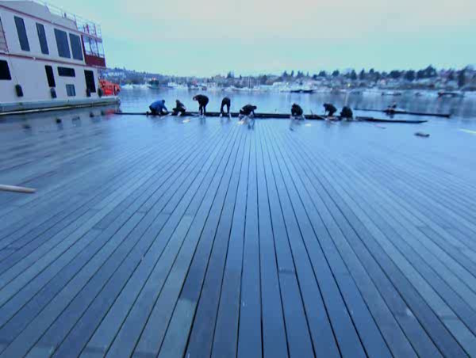
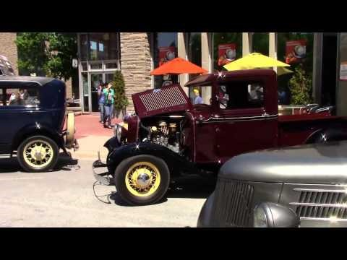




Notes:
Retro Television
(Intermediate)
To reproduce the effects on this slide, do the following:
On the Home tab, in the Slides group, click Layout, and then click Blank.
On the Insert tab, in the Images group, click Picture.
In the left pane of the Insert Picture dialog box, click the drive or library that contains the picture of the TV. In the right pane of the dialog box, click the picture that you want and then click Insert.
Select the image and under Picture Tools, in the Format tab, in the Picture Styles group, click Picture Effects, click Shadow, and under Outer, select Offset Top (third row, second option from left).
On the Home tab, in the Drawing group, click Arrange, point to Align then do the following:
Click Align Middle.
Click Align Center.
To reproduce the video effects on this slide, do the following:
On the Insert tab, in the Media group, click Video, and then click Video from File.
In the left pane of the Insert Video dialog box, click the drive or library that contains the video. In the right pane of the dialog box, click the video that you want and then click Insert.
On the Animations tab, in the Animation group, select Play.
Also on the Animations tab, in the Timing group, click the arrow to the right of Start and select With Previous.
With the video selected, under Video Tools, in the Format tab, in the bottom right corner of the Video Styles group, click the arrow opening the Format Video dialog box.
In the Format Video dialog box, click Size in the left pane, and under Size and Rotate in the right pane, set the Height to 3.58” and the Width to 4.75”.
In the Format Video dialog box, click Position in the left pane, and under Position on Slide in the right pane, set Horizontal to 2.6” and the Vertical to 1.36”.
Close the Format Video dialog box.
Select the video, and under Video Tools, on the Format tab, in the Adjust group, click Color, under Recolor, select Grayscale (first row, second option from left).
Select the video, and under Video Tools, on the Format tab, in the Arrange group, click Send Backward, and then select Send to Back.
To reproduce the background effects on this slide, do the following:
On the Insert tab, In the Illustrations group, click Shapes, then under Rectangles, select Rectangle (first row, first option from left),
Drag to draw rectangle on slide.
Under Drawing Tools, on the Format tab, in the Shape Styles group, click the arrow at the bottom right corner to launch the Format Picture dialog box.
In the Format Picture dialog box, select Fill in the left pane, under Fill on the right pane, select Picture or Texture Fill, then click the arrow to the right of Texture and select Oak (fifth row, third option from left).
Also in the Format Picture dialog box, select Line Color in the left pane, under Line Color on the right pane select No line.
Also in the Format Picture dialog box, select Size in the left pane, under Size and rotate on the right pane do the following:
In the Height box, enter 1.58”.
In the Width box, enter 7.5”.
In the Rotation box, enter 90 degrees.
On the Home tab, in the Drawing group, click Arrange, point to Align and then do the following:
Click Align Top.
Click Align Left.
Also on the Home tab, in the Clipboard group, click Copy, and then select Duplicate. Repeat this process five more times, for a total of seven rectangles.
Select one of the newly colored rectangles, under Picture Tools, on the Format tab, in the Arrange group, click Align and then do the following:
Click Align Top.
Click Align Right.
Press and hold CTRL, select all rectangles. Also under Picture Tools, on the Format tab, in the Arrange group, click Align and then do the following:
Click Align Top.
Click Distribute Horizontally.
Select the second, third, fourth, fifth, and sixth rectangles from left, under Picture Tools, on the Format tab, in the Size group, set the Height as 1.56”.
Press and hold CTRL, select all rectangles. Also under Picture Tools, on the Format tab, in the Arrange group, click Align, then select Distribute Horizontally.
Press and hold CTRL, select the first, fourth, and seventh rectangles from left. Under Picture Tools, on the Format tab, in the Adjust group, click Color, then under Color Saturation, select Saturation: 66% (first row, third option from left).
Press and hold CTRL, select the third and fifth rectangles from the left. Under Picture Tools, on the Format tab, in the Adjust group, click Color, then under Color Saturation, select Saturation: 200% (first row, fifth option from left).
Close the Format Picture dialog.
Select all of the oak panel rectangles.
Also under Picture Tools, on the Format tab, in the Arrange group, click Send Backward and then click Send to Back.
On the Insert tab, In the Illustrations group, click Shapes, then under Rectangles, select Rectangle (first row, first option from left).
Drag to draw rectangle on slide.
Under Drawing Tools, on the Format tab, in the Shape Styles group, click the arrow at the bottom right corner to launch the Format Picture dialog box.
In the Format Picture dialog box, select Fill in the left pane, under Fill on the right pane select Picture or Texture Fill, then click the arrow to the right of Texture and select Cork (fifth row, first option from left).
Also in the Format Picture dialog box, select Line Color in the left pane, under Line Color on the right pane select No line.
Also in the Format Picture dialog box, select Shadow in the left pane, under Presets on the right pane, under Inner select Inside Top (first row, second from left).
Also in the Format Picture dialog box, select 3-D Rotation in the left pane, under Presets on the right pane, under Perspective select Perspective Relaxed (second row, third from left).
Also in the Format Picture dialog box, select Size in the left pane, under Size and rotate on the right pane do the following:
In the Height box, enter 3.58”.
In the Width box, enter 11”.
Also in the Format Picture dialog box, select Position in the left pane, and under Position on Slide on the right pane, do the following:
In the Horizontal box, enter -0.5”.
In the Vertical box, enter 4.47”.
Close the Format Picture dialog box.
With the same rectangle selected, under Drawing Tools, on the Format tab, in the Arrange group, click Send Backward, select Send Backward.

Slide 2



ANNUAL GENERAL MEETING
HDTC-BIA
November 23, 2015
Tasty Lunch; 79 King Street West, Chatham, ON
8:00 am

Slide 3
Agenda
2015 Annual General Meeting
Monday November 23, 2015
At Tasty Lunch 79 King St. W, Chatham, ON
Breakfast at 8:00 am; Meeting at 8:30 am
Call to Order: Welcome and Introductions
Business Arising from AGM Meeting Minutes 2014
Approval of Minutes from AGM Meeting Minutes 2014
Approval of Agenda
Declaration of Conflict of Interest
Chairman Remarks: Paul Shettell
Secretary Remarks: Jim Carrington
Board Report:
Marketing and Promotion
Festivals and Events
Infrastructure updates
Financials
  Year to Date Projection
  2016 Proposed Budget
New Business
Next Meeting: Regular Board of Management Meeting January 12, 2016
Meeting Adjourned

Slide 4
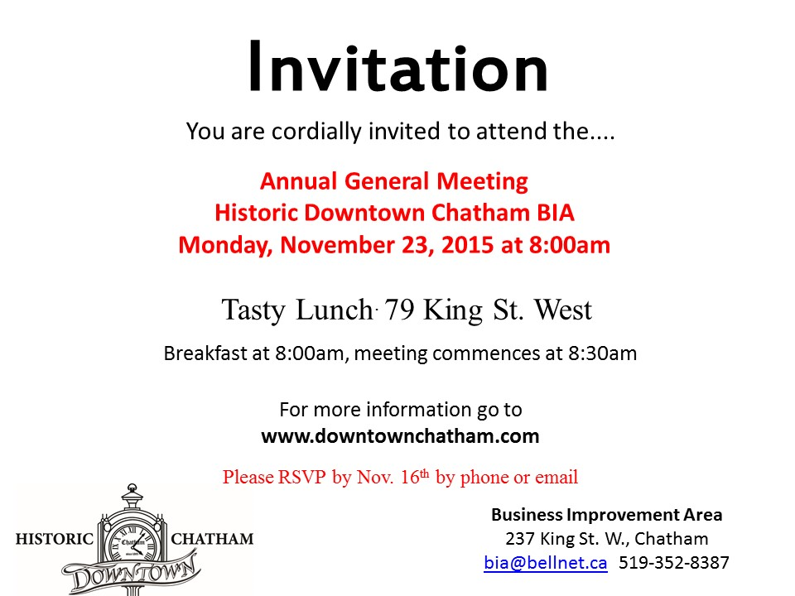

Slide 5
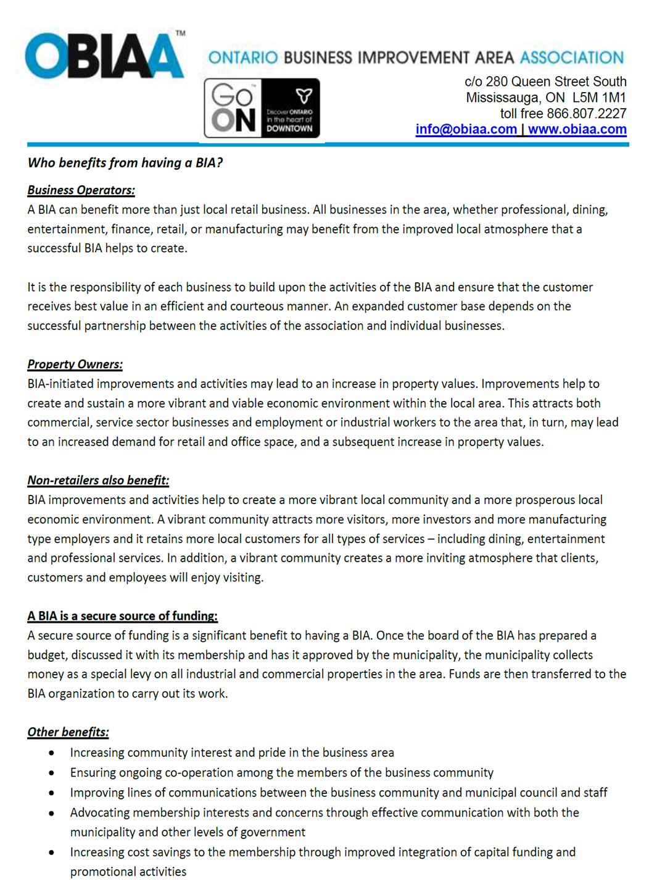


Slide 6

2014 Annual General Meeting Minutes
Historic Downtown Chatham BIA
Tuesday November 25, 2014
At JazzBah 270 King St. W, Chatham, ON
Appetizers at 6pm; Meeting at 6:30pm
ATTENDANCE: LYNN O BRIEN-DCC, JACLYN GILLIER-BIA, MARJOLAIN NADEAU-SHEPHERDS WAY INN, CAROL ANN HALL-JAZZ-BAH, JIM CARRINGTON-BIA, ASHLEY VAN ZELST-COMPLETELY U MASSAGE, BEN SROKOSZ-BIA, PAT CLARK-BUD GOWAN, PAUL SHETTELL-BIA, NANCY LABADIE-BIA, BARB ANDERSON-BARRY PATCH COLLECTIBLES, COLIN GOUDREAU-CHIROPRACTOR-DCC, JAMIE RIOUX-BIA, RYAN JACQUES-MCK, KATIE ZIMMER-1 UP COMMUNICATIONS, BRIAN WORRALL-MCK, LESLEY GRAND-CAPITOL THEATRE, CARSON WARRENER-LANDLORD, PATRICK PINSONNEAULT-LANDLORD, JEANIINE FOULON-PENNY SAVER, CONNIE BENETEAU-BIA.
Meeting called to order by Chair at 6:30 p.m.-Welcome and introductions.
APPROVAL OF MINUTES FROM AGM 2013:
-motion by Barb Anderson and Nancy Labadie to approve minutes. Carried
BUSINESS ARISING FROM PREVIOUS AGM MINUTES: NONE
APPROVAL OF AGENDA:
-motion by Jim Carrington and Nancy Labadie to accept agenda as presented. Carried
DECLARATION OF CONFLICT OF INTEREST: NONE
CHAIRMAN REMARKS: PAUL SHETTELL
-special thanks to the current board, Sgt. Jim Lynds and Connie Beneteau for another successful year
-refer to the packages and also yellow vote cards
-listing of events for 2014
-the next 4 years could be challenging with new by-laws being proposed by the Municipality of Chatham-Kent
-Shop the Neighbourhood
-HDTC-BIA should be attending conferences like FEO an OBIAA
-possibility of hosting the 2018 OBIAA
SECRETARY: JIM CARRINGTON
-final infrastructure report has gone to Council for approval
-a plea for more merchant involvement
-bringing back Fashion and the City on a smaller scale
-financials are clear and transparent

Slide 7
Page 2 of 3 2014 Annual General Meeting Minutes
BOARD REPORTS:
STREETSCAPE:
RYAN JACQUES: MCK
-update plans for revitalization of downtown streetscape
-the design was selected in September 2014
-the report has a phasing plan but timelines will be based on tender and contractor availability
-least amount of time will take three years with the longest being four years
MARKETING AND PROMOTION:
BRIAN WORRALL: MCK
-spoke on CK Branding
-a website has been created as an on-line resource with tools anyone can use with photos and videos
FESTIVAL AND EVENTS
-Shop the Neighbourhood, November 29, /2015
-Fashion and the City
-RetroFest™
-Santa Claus Parade
-First Friday
INFRASTRUCTURE: JIM CARRINGTON
-final infrastructure report has gone to Council and has been approved
FINANCIALS: JIM CARRINGTON
-comparison shown from 2010 through to 2015
-all financials are transparent and in your merchant package
-there is a $20,182.81 current projection of funds remaining on December 31st. This due to the HST from 2011 going through 2014. Also a stereo system was sold for 2600.00.
-motion by Lynn O’Brien and Nancy Labadie to reflect current carry-over from 2014 into 2015 revised budget. Carried
-motion by Lynn O’Brian and Jamie Rioux approve budget for 2015 with suggested changes. Carried.
NEW BUSINESS: NONE

Slide 8
Page 3 of 3 2014 Annual General Meeting Minutes
NOMINATION OF BOARD MEMBERS;
-motion by Paul Shettell and Barb Anderson to nominated Katie Zimmer. Carried
-motion by Ben Srokosz and Jaclyn Gillier to nominated Lesley Grand. Carried
-motion by Andrew Thiel and Jamie Rioux to nominate Jim Carrington. Carried
-motion by Nancy Labadie and Jim Carrington to nominate Jaclyn Gillier. Carried
-motion by Andrew Theil and Marjolaine (from Shepard’s Way Inn) to nominated Nancy Labadie. Carried
-motion by Jamie Rioux and Ben Srokosz to nominate Paul Shettell. Carried
-motion by Jim Carrington and Nancy Labadie to close nominations. Carried
Next AGM to be in November 2015. Date to be determined.
-motion by Barb Anderson and Lynn O’Brien to adjourn. Carried

Slide 9

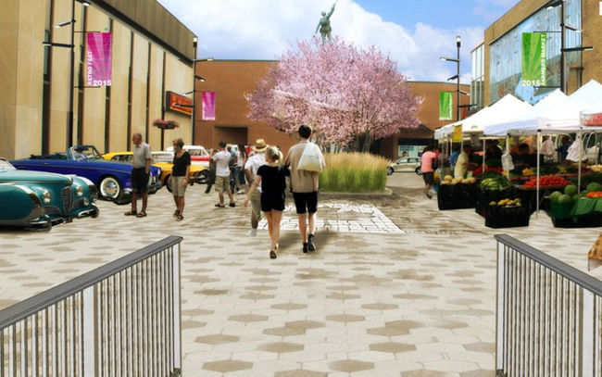
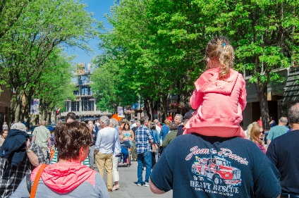
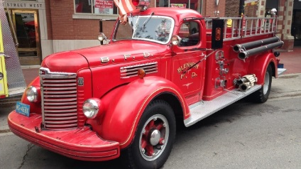
2015 Reports – Community Involvement / Events
The HDTC-BIA has participated in the Age-Friendly Chatham-Kent initiative. Starting in January 2015 was the start of monthly meetings. Age-Friendly policies can have an impact beyond the elderly, as mitigating age related barriers can improve the overall conditions for people of other ages. This call to action recommendations generated reports that went to Council on suggestion to improve in an area of Age-friendly, what the people would like to see. Presentations conducted to the community in Chatham, Tilbury, and Dresden.
Specific Municipal Council Meeting Such as Jan.20th Municipal Budget.
CK Branding presentations.
March 23rd Municipal Council Meeting for the BIA By-law changes. Meeting with Dave Vankestern over Grant issues.
Special Events meetings with Megan Robinson. Streetscape: Meetings with Ryan Jacques; property owners to gather input. Council meetings for support for the Downtown Chatham Streetscape
RetroFest™ Car Cruise; Car Show and Entertainment for the whole family. Meetings started in January with several groups including with the Municipality; KHAC club; Youth Festival (Optimist Club); Soapbox Derby; Sponsorship groups; the Havoc Rugby Team; Volunteers; and Vendors. Generate reports and budgets.
Economic Impact Training; Advertising; Registration;
Assisted with Firefest Downtown Chatham. September 18th & 19th. Hosted by Brent Denure

Slide 10


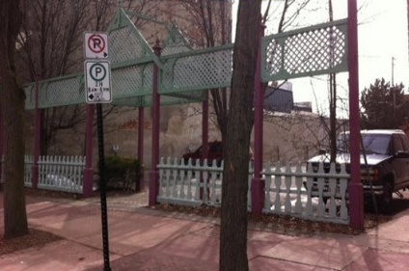
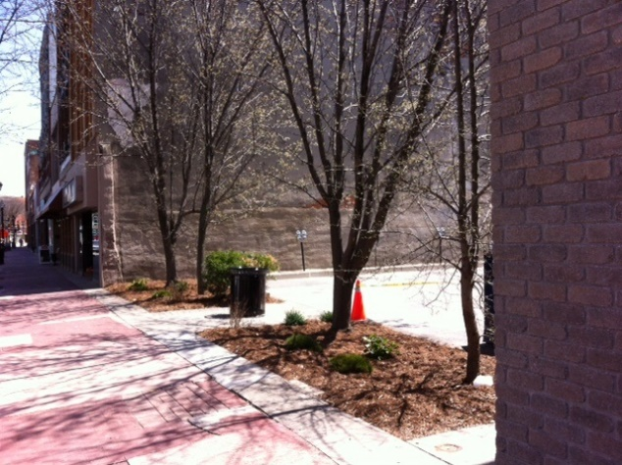
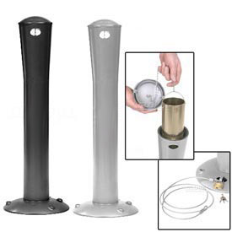
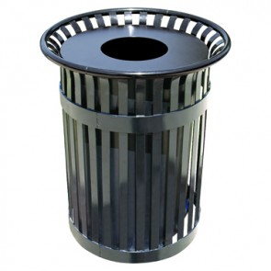
The HDTC-BIA is working with a Realty House representative to high light the vacant buildings and store fronts that are available Downtown Chatham. We have also had the website redesigned to reflect these properties.
Sidewalk Sales and DLD were scheduled for June 27th. Several merchants were ready to have their sales on that day. Unfortunately, the weather did not cooperate. DLD rescheduled for Aug. 22nd but that was too late for the Retail sector to have sales.
May 2nd we partnered with the volunteers from Union Gas –The Helping Hands Group. The lattice between Goldcoast and Spanky’s was torn down, as this had become an eye-sore and garbage collecting along the bushes.
After all the clean up, we planted new plants, and added a new garbage receptacle. All work was done before RetroFest™.
Ash Urns and Ash Trays were all identified. The broken or damaged ones were removed and new ones were installed. Ash urns need to be cleaned out and new sand replaced periodically.
May of the inserts on the garbage receptacles are old and brittle. These needed to be removed and new ones replaced. One on 4th Street was so badly damaged, a new one had to be installed.
8

Slide 11
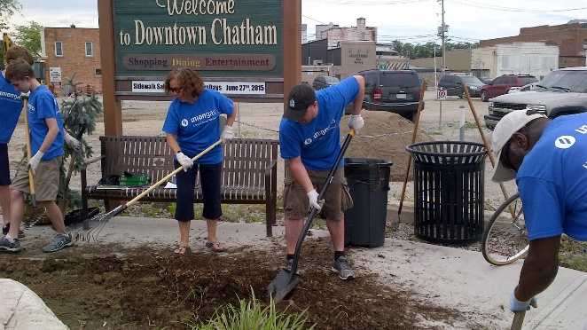
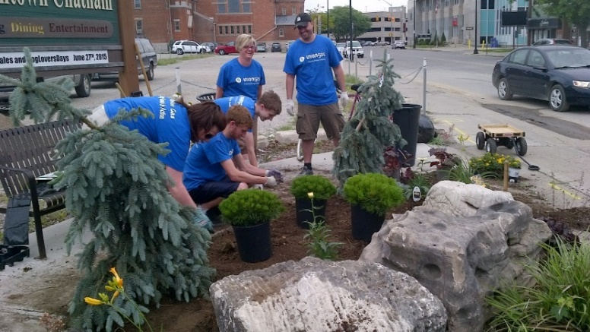

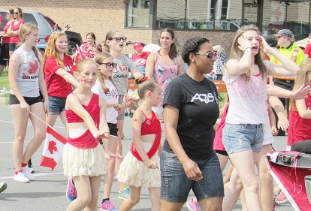
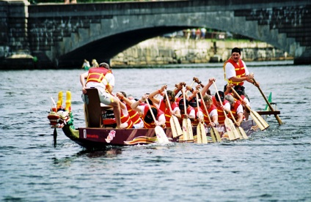
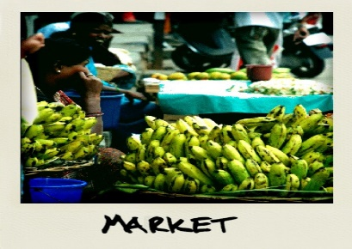
Beautification: The old gardens around the Gateway Signage areas were dug up and replanted with fresh plants and mulch before Communities in Bloom judges arrived.
Also the planter boxes were re-planted between Scotia Bank and TD Bank.
Age-Friendly Chatham-Kent, Generated reports that went to Council on suggestion to improve in an area of Age-friendly, what the people would like to see.
This year we organized a Chatham-Kent BIA Regional Meeting. A member of the Municipality use to conduct these meetings but no longer do. We felt it was important to have all the C-K BIA’s work together. A number of topics were addressed and a consensus was reached to continue these meetings in the future.
Assist with Canada D’eh in Tecumseh Park
Assist with Olympic Torch Run down the River and in Tecumseh Park
The HDTC-BIA continuous to look ng into other events such as First Fridays; Fashion And The City; Lock it or Lose it; & Farmer’s Market, as long as there is merchant participation.
9

Slide 12

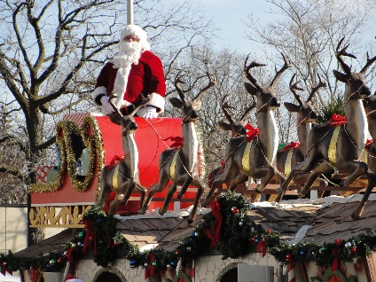



Tourism: this year the HDTC-BIA Attended many meetings with representatives from Municipality of Chatham-Kent, John D. Bradley Centre & other groups for ways to encourage new visitor/ groups to come to our downtown. Also meetings and webinars on Celebrate Ontario Grants and Tourism Grants that have new requirements.
Audits: It is a new requirement from CK Municipal By-laws that all BIA’s be audited. The audits started back at 2012
Sponsorship: Santa Claus Parade; assist with advertising on gateway signs; Union Gas signs; CK Calendar posts.
Shop the Neighbourhood. Encourages people to shop local with free advertising from the Yellow pages group. 2014 was the first year we were able to participate. 2015 #shopthehood is November 28th.
Websites, Social Media, Print and Radio Advertising.
Others: Banners; Shooting Stars; Lights in the trees; United Way – Big Bike Ride. Tents and Tables loaned to charity groups
10

Slide 13
Account Activities

Slide 14
Account Reconciliation

Slide 15

Projected Year End Budget
For December 31, 2015

Slide 16

2014 | Levy | 60,000
2015 | Levy | 80,000
2016 | Levy | 80,000
2016
Proposed Budget
Revenue
BIA Levy |  |  | $80,000
Events Sponsorship /Grants/ Vendors | (unknown number)
 | Total Revenue | Revenue: |  | $80,000.00
Expense
Administrative Expense | Office Communication | $1800
 | Office Supplies/Equip | $2500
 | Repair & Maintenance | $1000
 | Bookkeeping | $2000
 | Office Staff | $40000
 | Guests & Speakers | $200
 | Membership | $900
 | Website Maintenance | $1000
 | BIA Advertising | $4500
 | Interest/Bank Charges | $50
 | Beautification | $2000
 | Municipal Fixed Costs | $3300
 | Volunteer /Appreciation | $500
 | Misc. | $250 | $60,000
Events/Sponsorship |  | $14500 | $14500
Marketing |  | $5500 | $5500
 | Total Expenses |  |  | $80000.00
Potential HST Rebate | $2,500 | Horticul | Levy | $13000

